Slide 1
Chapter 14
Health and Well-Being

Slide 2
Health Psychology
The application of psychology to the promotion of physical health and the prevention and treatment of illness
  The modern medical perspective holds that health is a joint product of biological, psychological, and social factors.

Slide 3
Stress
What causes stress?
  What it does to the body?
Key question for social psych: How do we appraise stressful situations in order to cope with them?

Slide 4
Stress
A state of arousal that arises when we perceive that the demands of a situation threaten our ability to cope effectively
  Our subjective appraisal of the situation determines how we will experience the stress and what coping strategies we will use to try to reduce the stress.

Slide 5
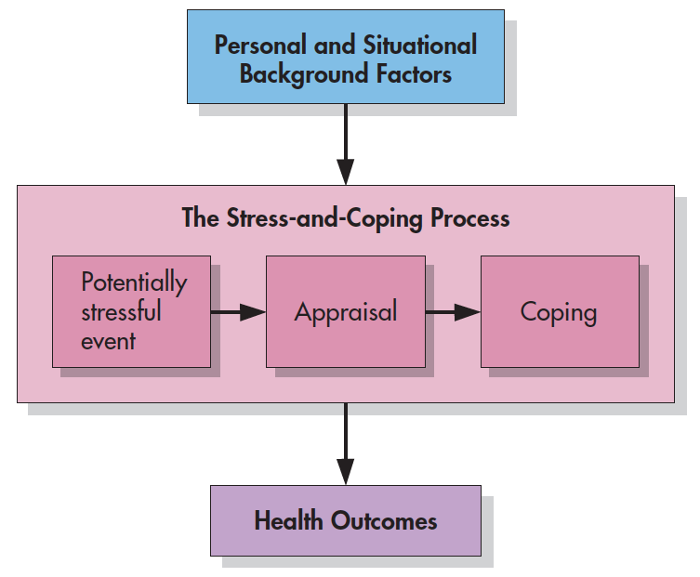
The Stress-and-Coping Process
Notes:
Figure 14.1 The Stress-and-Coping Process This process involves a potentially stressful event, the appraisal of that event, and attempts to cope. Played out against a variety of background factors unique to each individual, the stress-and-coping process influences health outcomes.

Slide 6
The Stress-and-Coping Process
Notes:
Figure 14.1 The Stress-and-Coping Process This process involves a potentially stressful event, the appraisal of that event, and attempts to cope. Played out against a variety of background factors unique to each individual, the stress-and-coping process influences health outcomes.

Slide 7
Measuring the Effects of Stress
Self-reports
  Life-event checklist, daily diaries, and interviews
Physiological measures
  Stress hormone levels, recording autonomic arousal, and accumulated levels of cortisol

Slide 8
Major Life Events
Change itself can cause stress by forcing us to adapt to new circumstances.
  Social readjustment rating scale
Is change per se necessarily harmful?
  No support that positive “stressors” are as harmful as negative stressors
  The impact of change depends on who the person is and how change is interpreted.

Slide 9
Microstressors
Most common source of stress arises from the hassles that irritate us every day.
“Microstressors” place a constant strain on us.
  The accumulation of daily hassles contributes more to illness than do major life events.
  Job burnout, commuting, financial pressure, etc.
Socioeconomic status (SES) is a powerful proxy for the hassles of everyday living.

Slide 10
Stress and the Body
General Adaption Syndrome: A three-stage process (alarm, resistance, and exhaustion) by which the body responds to stress.
Designed for acute physical emergencies, not prolonged mental or emotional stressors

Slide 11
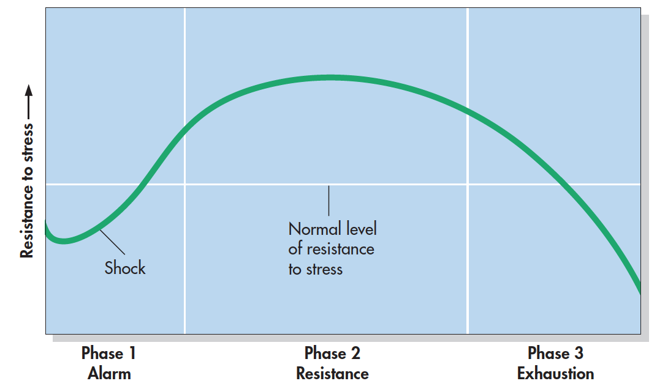
The General Adaptation Syndrome (Seyle, 1936)
Notes:
Figure 14.2 The General Adaptation Syndrome According to Selye (1936), the human body responds to threat in three phases: alarm, resistance, and exhaustion. Selye, H. (1936). A syndrome produced by diverse nocuous agents. Nature, 138, 32.

Slide 12
What Stress Does to the Immune System
Psychoneuroimmunology (PNI)
  A subfield of psychology that examines the links among psychological factors, the brain and nervous system, and the immune system
Brief stressors can enhance the immune response.
Chronic life stressors can suppress the immune response over time.

Slide 13
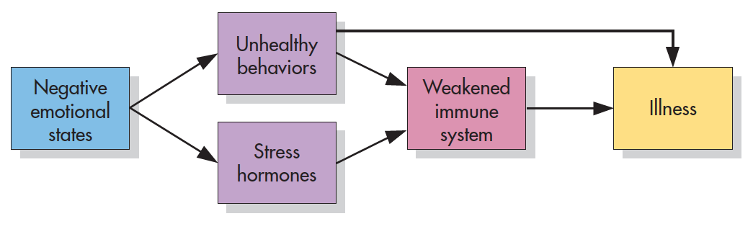
Pathways From Stress to Illness
Notes:
Figure 14.3 Pathways from Stress to Illness Hostility, stress, and other negative emotional states may cause illness in two ways: (1) by promoting unhealthful behaviors (more alcohol, less sleep, and so on) and (2) by triggering the release of hormones that weaken the immune system.

Slide 14
The Links Between Stress and Illness
Chronic stressors are more toxic than others.
Personal characteristics and life circumstances can buffer people against the adverse health effects.
  The more sociable people were in life, the more resistant they were to developing the lab-induced cold.

Slide 15
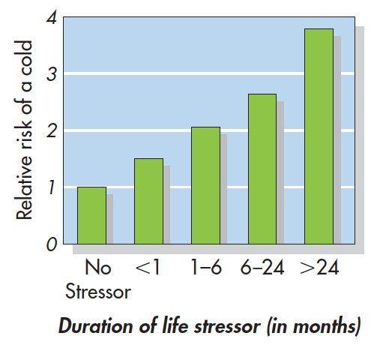
Stress Duration and Illness
Notes:
Figure 14.4 Stress Duration and Illness Two hundred seventy-six volunteers were interviewed about recent life stress, then infected with a cold virus. As shown above, the more months a stressor had lasted, the more likely a person was to catch the cold. Over time, stress breaks down the body’s immune system. Cohen et al., 1998.

Slide 16
Attributions and Explanatory Styles
Learned helplessness
  The acquired expectation that one cannot control important outcomes.
  Example: people exposed to inescapable bursts of noise thus failed to protect themselves in a later situation where the noise could be easily avoided.
  Low situational control == feelings of helplessness
  Less likely to try and remove themselves from high stress situations

Slide 17
The Human Capacity for Resilience
Why are some people more resilient to stress than others?
Resilient people share three characteristics
  Commitment—a sense of purpose with regard to one’s work, family, and other domains.
  Challenge—an openness to new experiences and a desire to embrace change.
  Control—the belief that one has the power to influence important future outcomes.

Slide 18
Self-Efficacy
Feelings of competence; varies from one specific task and situation to another
More self-efficacy == more likely you are to take on a specific task, try hard, persist in the face of failure, and succeed.

Slide 19
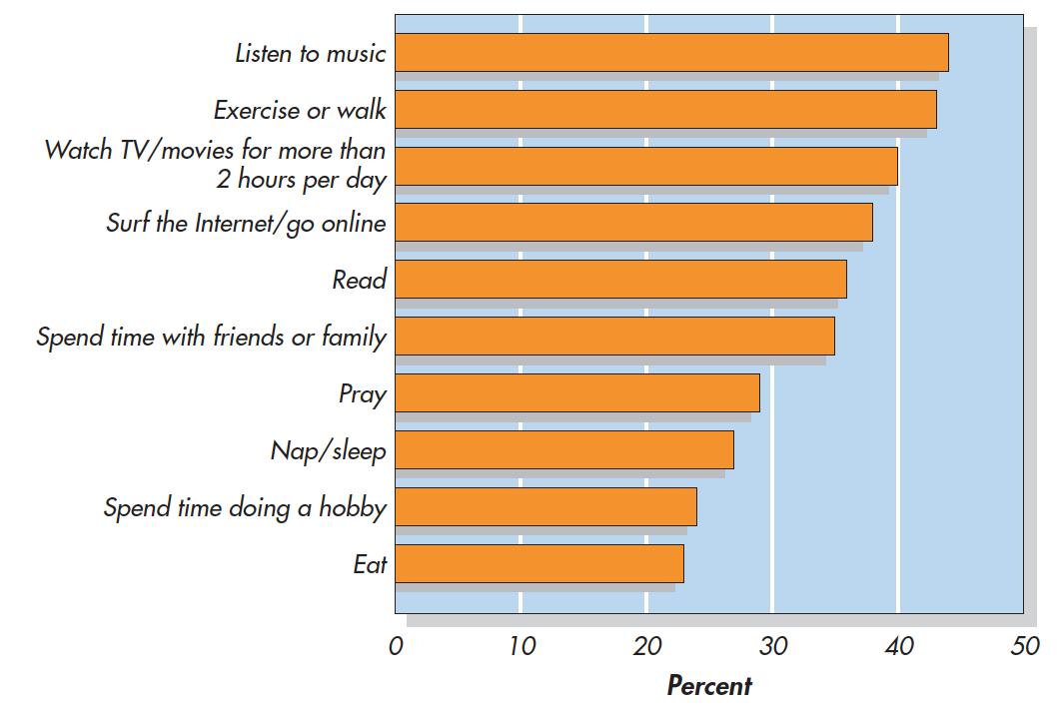
How Americans Manage Stress (APA, 2015)
Notes:
Figure 14.8 How Americans Manage Stress There is no single way to manage stress. When American men and women were asked to indicate how they do it, the list that emerged was quite varied. Here are the top 10 most cited responses. From American Psychological Association (February 4, 2015). Stress in America. Copyright © 2015 by the American Psychological Association.

Slide 20
Coping with Stress
Remove the source of the stress (problem-focused)
Change how we respond to the stress (emotion-focused)
Is one approach better than the other?

Slide 21
Problem-Focused Coping
Cognitive and behavioral efforts to reduce stress by overcoming the source of the problem.
  It is better to confront and control than to avoid them.
Problems:
  Is physiologically taxing
  Can cause problems if it leads us to develop an overcontrolling, stress-inducing, Type A pattern of behavior

Slide 22
Emotion-Focused Coping
Efforts to manage our emotional reactions to stressors rather than trying to change the stressors themselves
  Positive emotions: Building blocks of emotion-focused coping
  Shutting down: Suppressing unwanted thoughts
  Opening up: Confronting one’s demons
  Self-focus: Getting trapped versus getting out

Slide 23
Subjective Well-Being (SWB)
One’s happiness, or life satisfaction, as measured by self-report
  In self-reports, 75% of American adults rate themselves as happy.
Key predictors of happiness
  Social relationships
  Employment status
  Physical and mental health

Slide 24
Does Money Buy Happiness?
Is wealth truly a key to happiness?
  To some extent, yes, but the evidence is more complex.
  The more materialistic people are, the less satisfied they seem to be.
Perceptions of wealth relative to certain personally set standards.
  Social comparison theory!

Slide 25
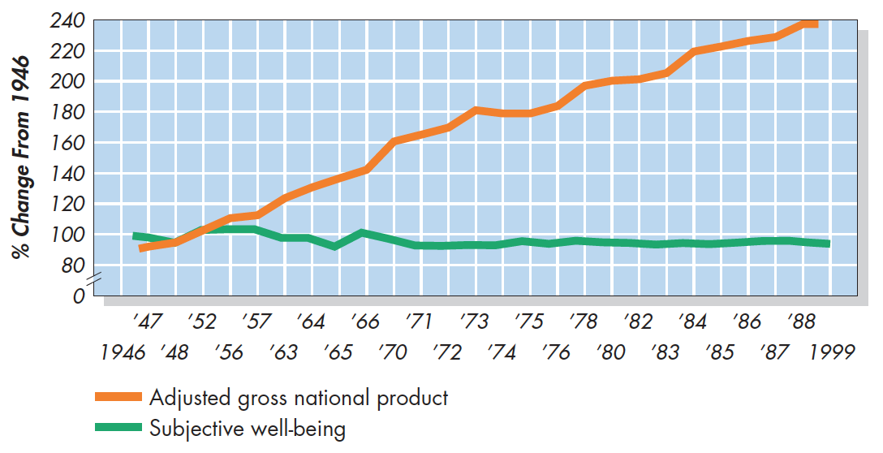
Wealth and Subjective Well-Being (Kassin, 1997)
Notes:
Figure 14.14 Wealth and Subjective Well-Being Over a period of more than 40 years, Americans became twice as wealthy, as measured by adjusted per person income—but they were not happier, as measured in public opinion polls. From Kassin (1997).

Slide 26
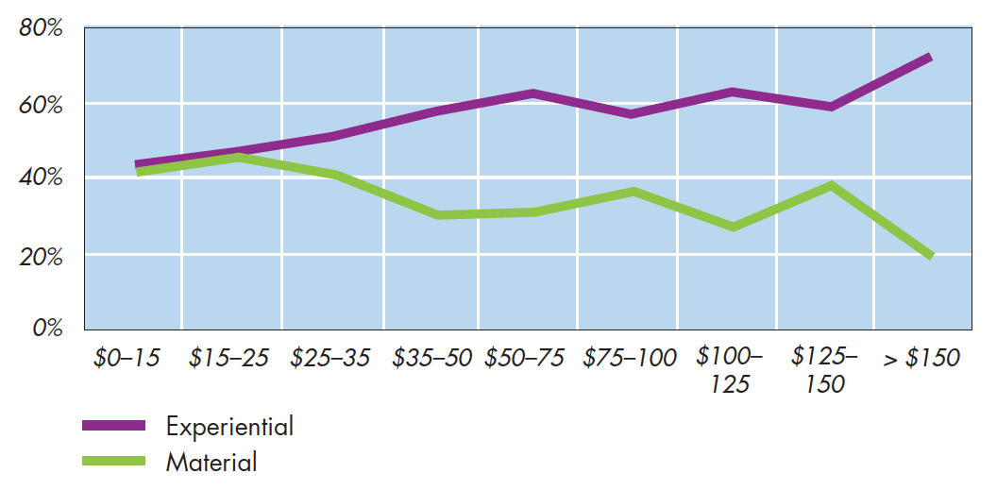
What Yields More Happiness: Experiences or Material Objects? (Van Boven, 2005)
Notes:
Figure 14.15 What Yields More Happiness: Experiences or Material Objects? After recalling a time when they spent money on an experience or a material object, people in general said that the experiences they purchased made them happier than the material objects. From Van Boven (2005).

